Slide 1

Heredity and Evolution
Asexual reproduction
Inheritance

Slide 2

What happens when a single individual reproduces as in asexual reproduction

Slide 3
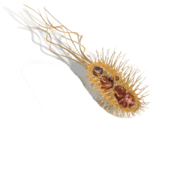
There would be only very minor differences between them, generated due to small inaccuracies in DNA copying.
changes
If one bacterium divides,
and then the resultant
two bacteria divide again,
the four individual
bacteria generated would be very similar.

Slide 4
The most obvious outcome of the reproductive process still remains the generation of individuals of similar design.

Slide 5

Heredity determine the process by which traits and characteristics are reliably inherited.
Lets understand inherited traits with an example.
What are inherited traits / characters and how these characters are inherited ???

Slide 6
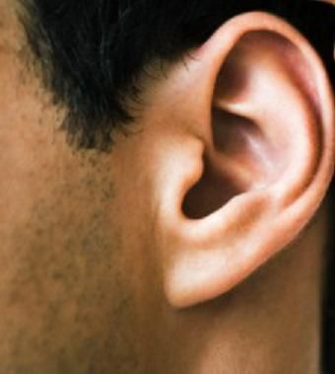
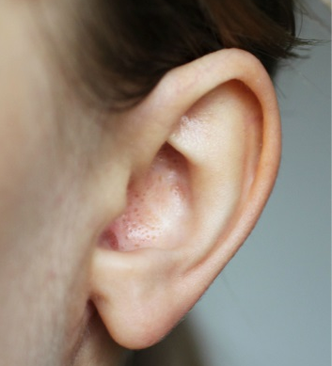


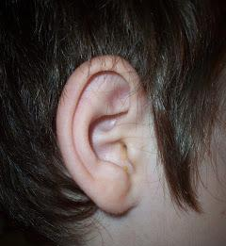
Suppose a male with attached ear lobe
marries a female with free
ear lobe
So we can say child has inherited the trait of attached ear lobe from his father
Attached Ear lobe
Free Ear lobe
What will be their child's ear lobe will look like???
The ear lobe can be either attached or free
It is observed the child has attached ear lobe
Attached

Slide 7
But, why the free ear lobe trait from mother has not been inherited???

Slide 8
Thank You

